Slide 1

MANUFACTURING OF ZERO TOLERANCE FIT PRODUCT USING WIRE EDM
Department of Mechanical Engineering Indian Institute of Technology Guwahati
Manufacturing Technology Ⅱ(ME312) course project

Slide 2
Team Members:
Course Instructor:
Prof. U. K. Komal
Rahul Yadav 230103123 Ajay Pratap Singh 230103132

Slide 3
CONTENTS
01
04
02
05
03
06
Machine
Introduction
Objective
Theory & Procedure
Basic Idea
Results & Analysis
07
Concluding Statement

Slide 4
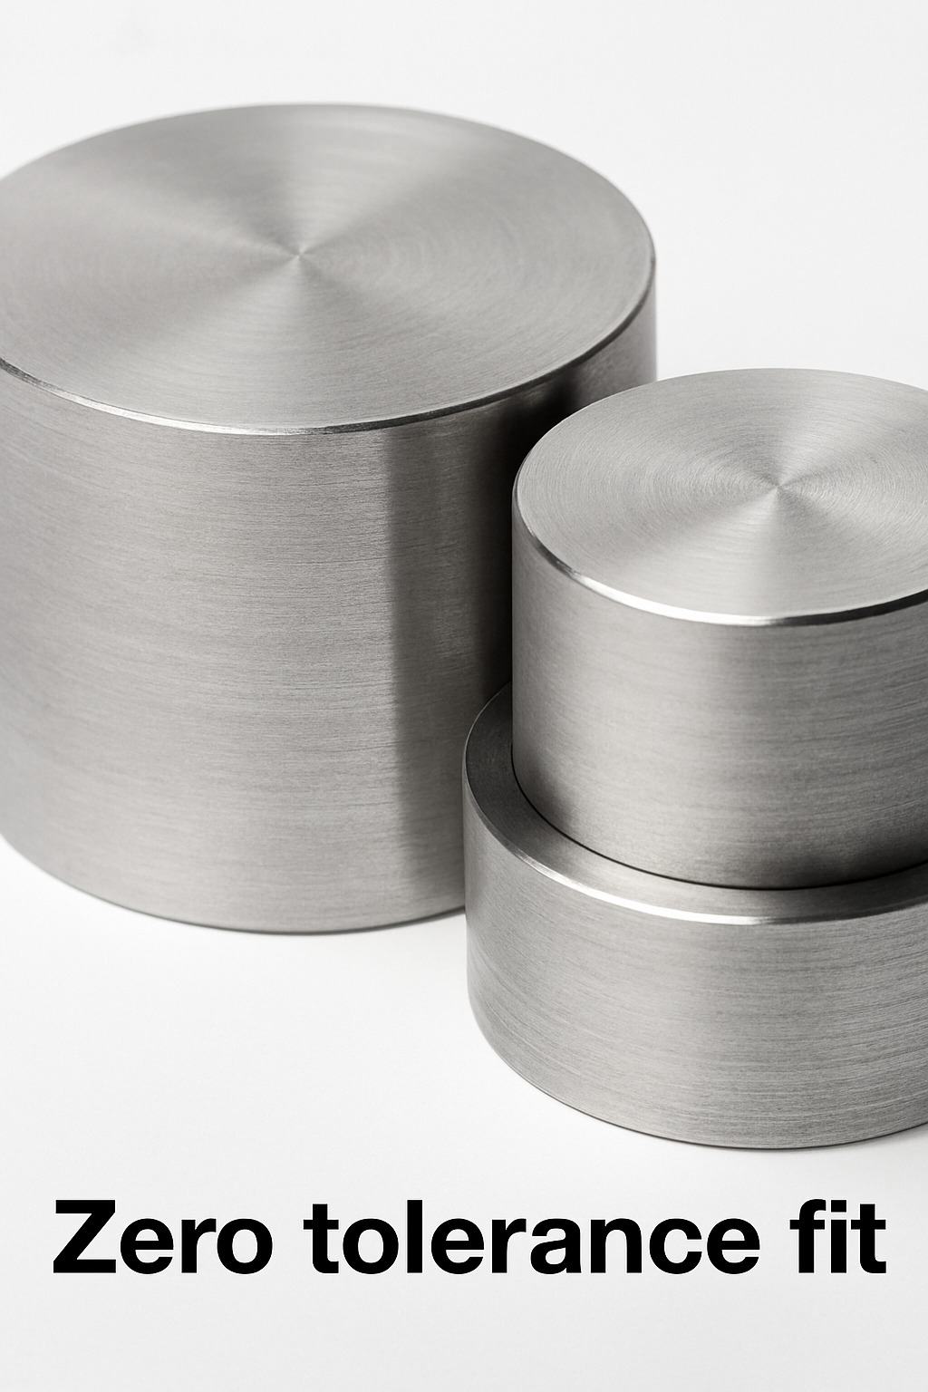
INTRODUCTION
Sometimes, tolerances in manufactured products are a great hindrance to the function of the equipment, like in sealing.
Therefore, it becomes necessary to check and try newer machining methods that can handle the problems arising from old conventions.
It has also found some advanced applications other than sealing, like being motion guides for slow but accurately moving parts.

Slide 5
OBJECTIVES
To try wire electric discharge machining (EDM) as an option to remove tolerance in component fits.
Achieve ultra-high dimensional accuracy by using Wire EDM to produce components with near-zero-tolerance variation.
Also, to get a generic idea of machining time in this process.
Ensure perfect component fit to eliminate assembly issues, misalignment, and unwanted play.
A simple semi-circular geometry was cut during the first trial of precision cutting.

Slide 6
BASIC IDEA
Wire Electrical Discharge Machining (EDM) uses a thin, continuously-fed conductive wire as an electrode to cut intricate shapes in electrically conductive materials.
A series of sparks, controlled by a program, erodes the workpiece by melting and vaporising material without direct contact, achieving high precision and excellent surface finish.
This process is carried out in a dielectric medium, generally de-ionised water.
Dielectric ensures the electric insulation and then breaks down to erode the workpiece by producing an electric discharge.
Since it is done electrically using a controlled voltage and current, production of a part with exceptional dimensional accuracy is expected.

Slide 7
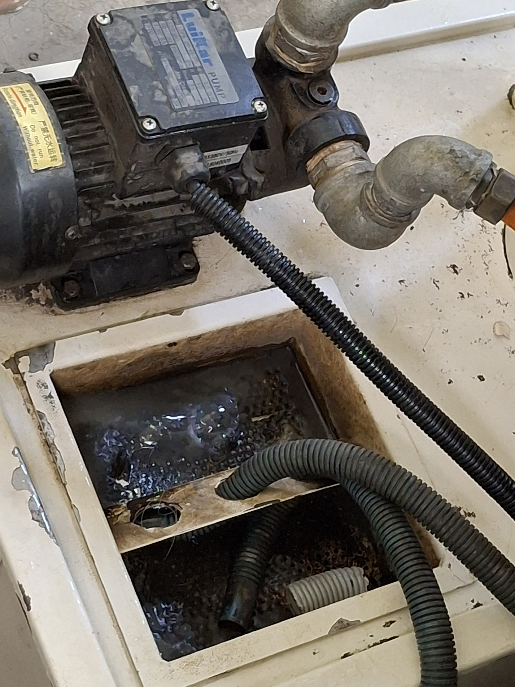
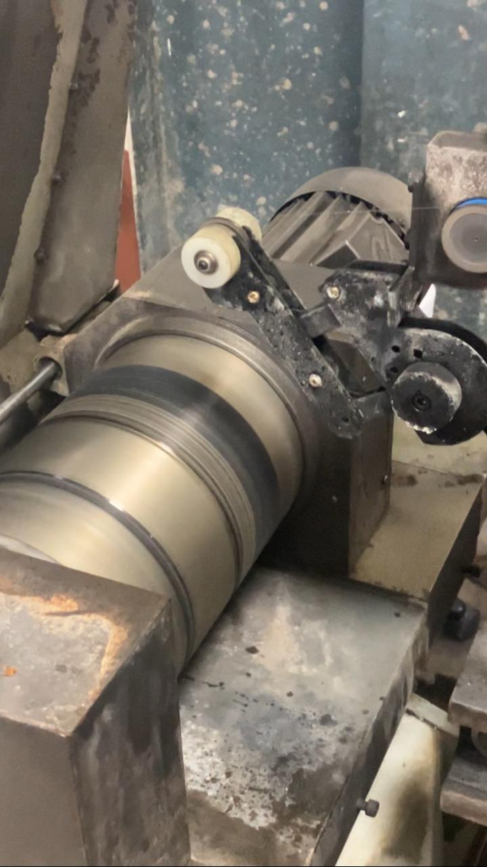
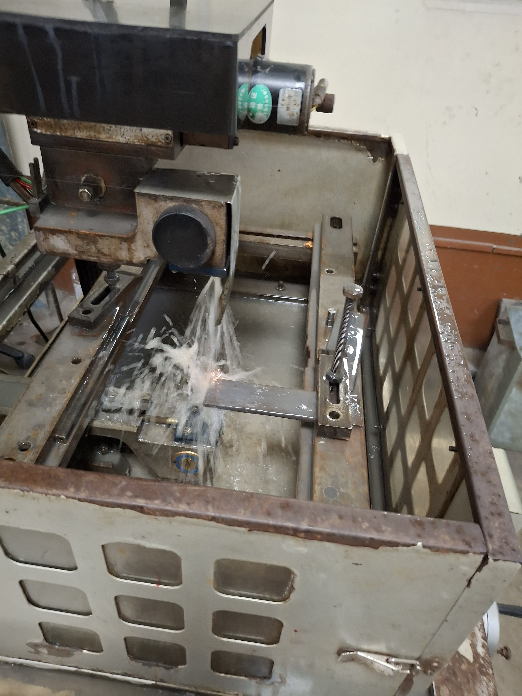
Machine
De-ionised water storage tank
Wire Bundle
Cutting head

Slide 8
Procedure
It is done with two similar metal pieces, one cut using the wire EDM process, and the other is cut from another bar, adjusting for the wire diameter to obtain an absolute fit, just a repetition of the procedure.
The bar is fixed on a fixed rail, and the dielectric flow is turned on; instructions are fed by a CAD drawing.
An electrical voltage is applied between the wire (cathode) and the workpiece (anode), creating an electrical field. When the gap between them is sufficiently small, the dielectric fluid ionises, allowing a controlled spark to erode the workpiece.

Slide 9
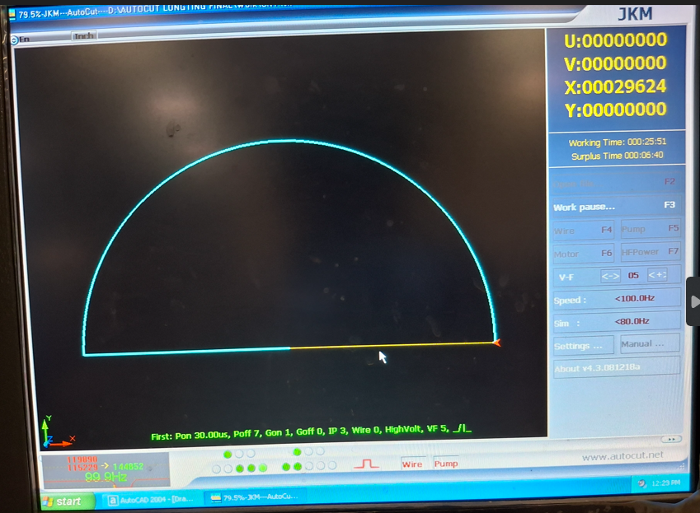
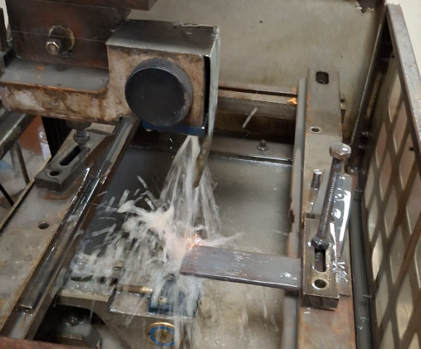
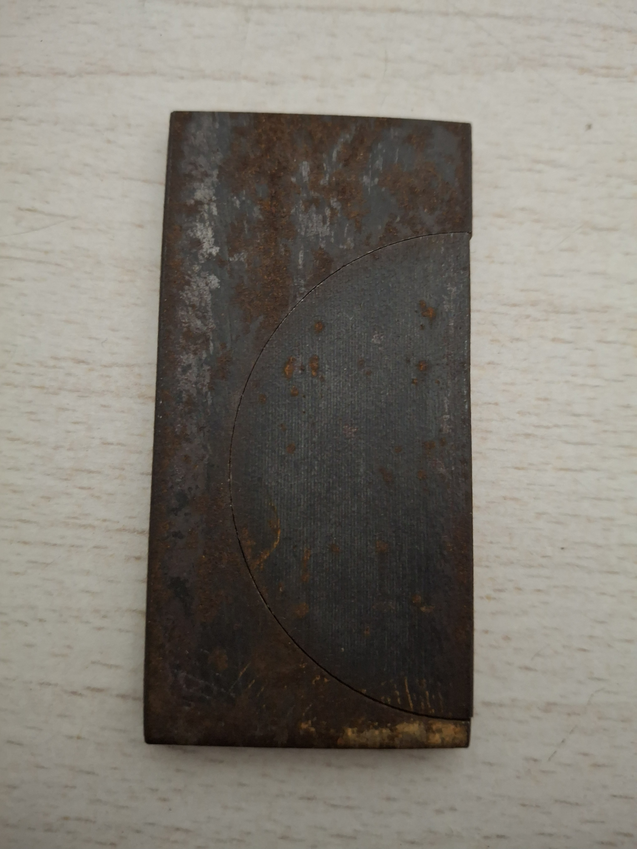
3. Material Erosion: Each spark generates intense localised heat, causing a tiny amount of material on the workpiece surface to melt and vaporise. This material then solidifies into small debris particles that are carried away by the continuously flowing dielectric fluid.
4. Wire Movement & Continuous Cutting: The wire continuously feeds through the workpiece, guided by upper and lower guides, while maintaining a constant gap. The CNC system precisely controls the wire's path, dictating the shape of the cut as it incrementally removes material through repeated spark discharges.
CAD Drawing
Working Process
Cut Pieces
Final Product

Slide 10
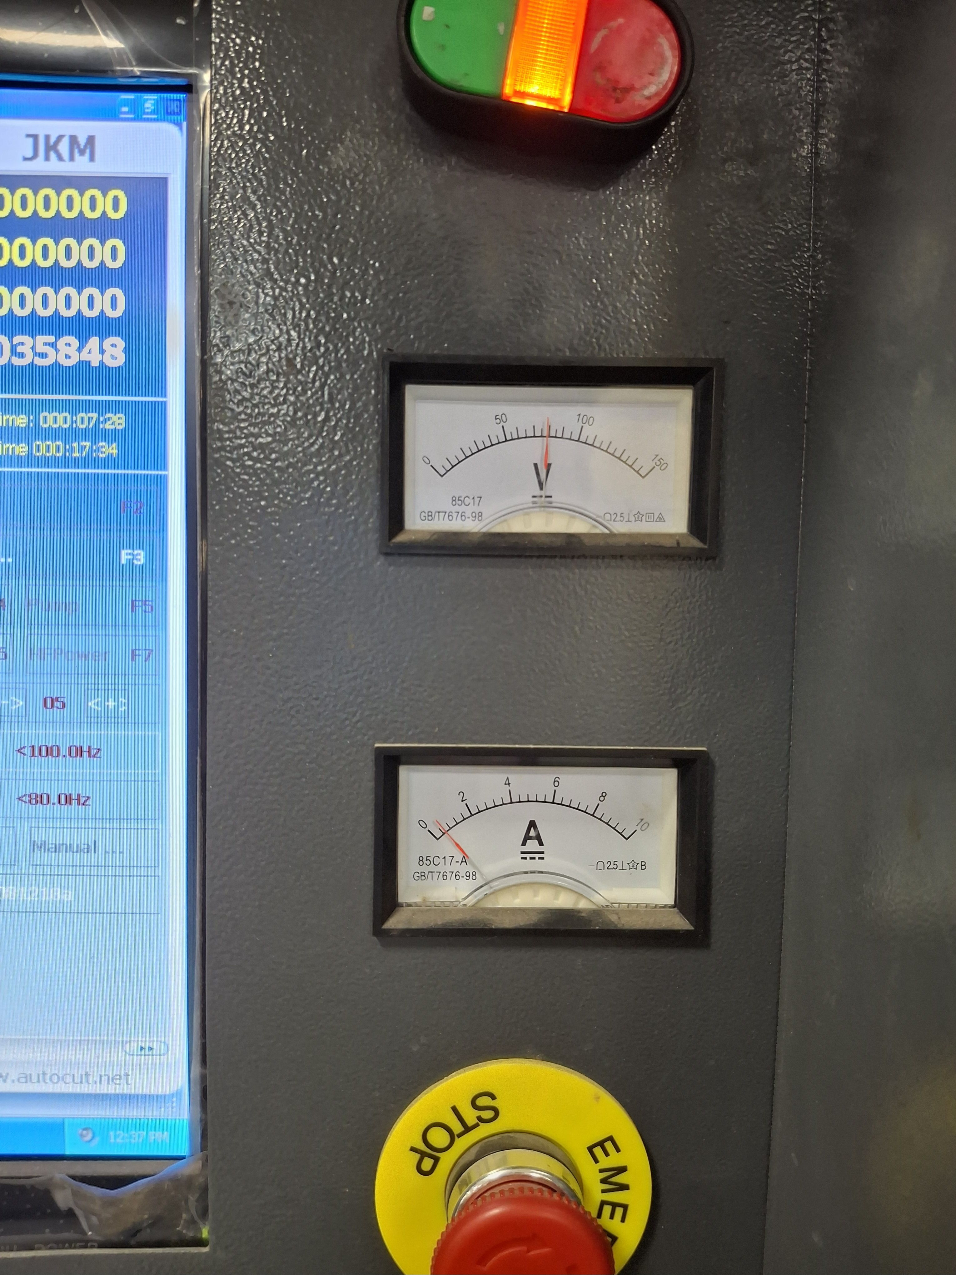
Voltage or Current
Voltage and Current:
It can be seen from the image on the right-hand side that it is the voltage that needs to be high; current is around 0.4-0.5 A, whereas the voltage is around 80 V during regular operation.
This amount of current can be observed almost anywhere, but the high voltage is especially required for the breakdown of water.
The local current within the dielectric may be high, but that does not travel through the wires. It is locally generated and circulated between the workpiece and the wire.

Slide 11
Final Output

Slide 12
Results and Analysis
The Product:
It was prepared using two separate bars (visit the last slide), so that the wire diameter could be adjusted for.
Obtained a product with very high accuracy (compared to the conventional machining processes).
The product obtained was excellent, extremely good finish in the cut part and low tolerance.
Observe a very low seam in the picture on the right-hand side.
Elimination of the seam, however, could not be done. The next slide tries to figure out the reasons.

Slide 13
The visible seam:
With the seam, there is a slight misorientation that can also be observed.
We find this misorientation to be one of the reasons for the visible seam.
The two bars on the rail were slightly misoriented due to the reason that straightness was observed using a conventional straight edge, which made the other part slightly skewed to the initial part.
Resultantly, the part could not be fitted perfectly.
Another reason is that we could not optimise the machining parameters like duty cycle and the feed rate.
One more reason is that the wire diameter was not known precisely; we were told it was 0.1 mm, and we used it.

Slide 14
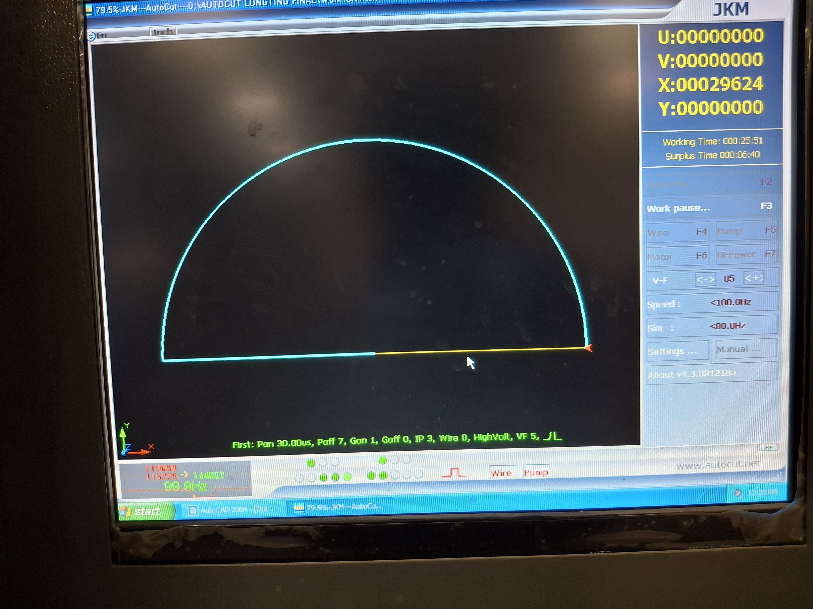
Machining Time

Slide 15
Results and Analysis
The Machining Time:
To cut simply one semicircular piece, the time taken was 32 minutes and 31 seconds.
We needed to align the second piece as well, almost parallel to the first piece, which took several minutes.
Then, again, the same process that added half an hour more.
Then, to remove the excess material, it took around 20 minutes.
Overall, it resulted in around two hours for this simple geometry.

Slide 16
Concluding Statement
Though good results can be obtained using wire electric discharge machining, it is still not a very good way of eliminating the tolerance.
Since it uses double the material that actually goes into the use, it is a waste of material and time as well.
It should be preferred only when the manufacturing of such a component is extremely necessary and no other machining process can do better on that.
We must explore alternatives that save the material, energy and time, all three, as all of them are used twice as much as necessary.

Slide 17
Thank You

